Slide 1
Bootstrap 2

Slide 2
Bootstrap 2
Prep Work
Complete in class assignments and upload them to the server in the public_html/class-samples folder
Send instructor a link to your assignments
Work On Treehouse, Responsive Layouts [47 min]
https://teamtreehouse.com/library/responsive-layouts
Work On Treehouse, Framework Basics [463 min] https://teamtreehouse.com/library/framework-basics

Slide 3
Bootstrap 2
Today’s Topics
Spacing Continued
Grids Rows and Columns
Image and Headings
Margins,Offsets and Reordering
Navigation and Navbar Components
Jumbotrons
Dropdowns and Buttons
Cards
List Groups

Slide 4
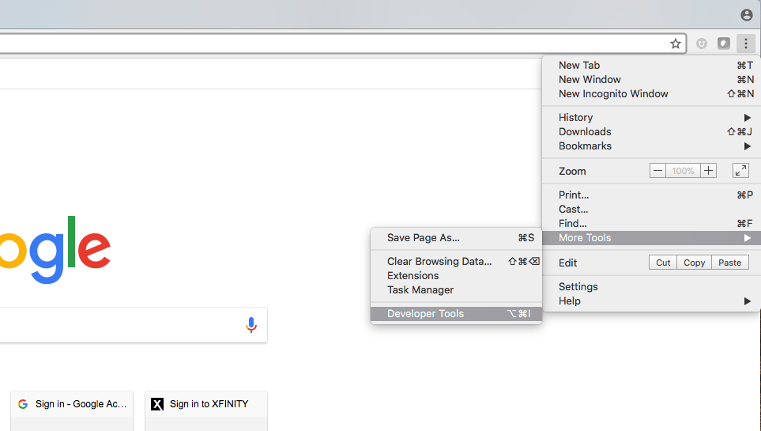
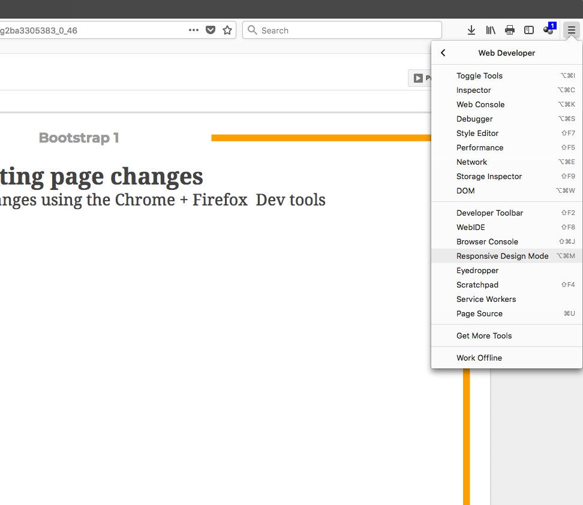
Bootstrap 2
Testing Page Changes
You Can test your changes using the Chrome + Firefox Dev tools
Chrome Firefox

Slide 5
Bootstrap Grids

Slide 6
Bootstrap 2
Layouts / Grids and Responsive Images
Three Parts to the Grid System:
Containers (required for grid)- class="container"
class="container" Centers and adds padding to Site Content
class="container-fluid" spans the width of the page
Rows- Must be added before columns can be defined class="row" (horizontal)
Columns- Are always nested inside a row, are children of the row, use a device size prefix class="col" + Number of Columns can be specified by class # or number of columns to span and device (phones, tablets, desktops and large form desktops). You can specify the actual number of columns or let them layout with equal width
(Can have 1-12 columns per row - with a Max of 12 per row)

Slide 7
Bootstrap 2
Layouts Grids and Responsive Images
Has 5 device classes
Extra Small (iPhone 4)- col-
Small (Phones)- col-sm-
Medium (Tablets)- col-md-
Large (Desktops)- col-lg
Xtra Large (Form Desktops)- col.xl-

Slide 8
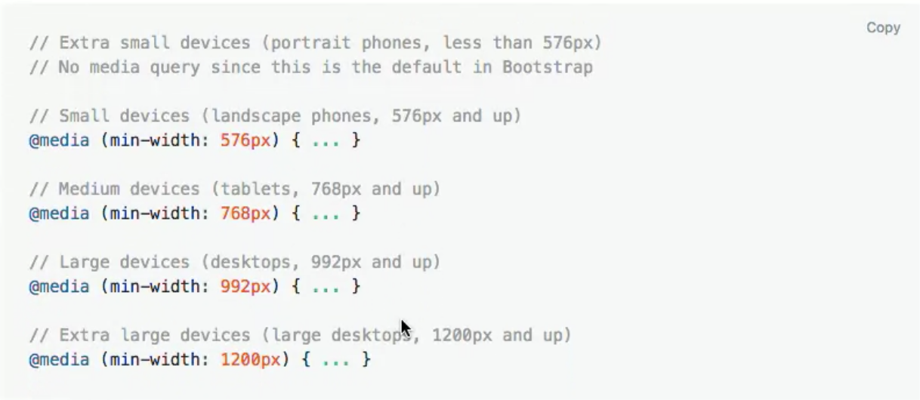
Bootstrap 2
Bootstrap Media Query Ranges

Slide 9
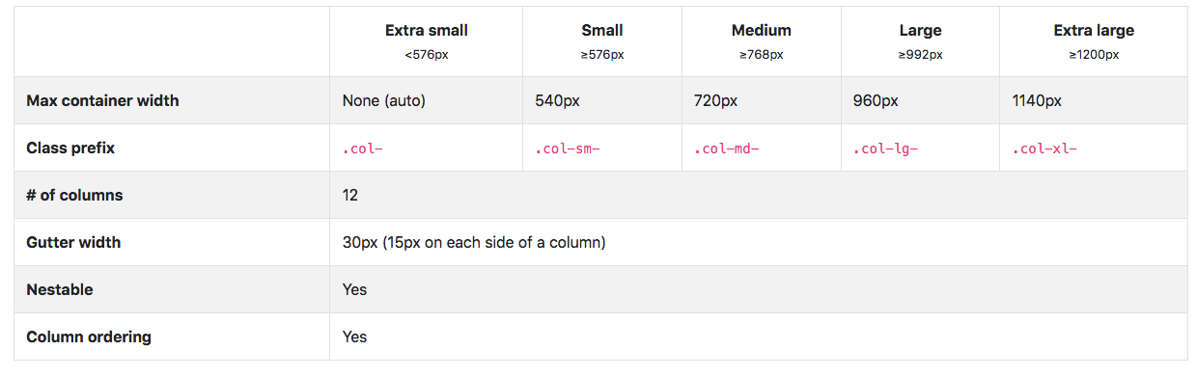
Bootstrap 2
Bootstrap Grid Options

Slide 10
Bootstrap 2
Rules of the Rows
The row or class="row" class creates a row for columns to nest inside
<section class= "row"><article>Col 1</article></section>
Can have 1 to 12 columns in a row
Rows have -15px margin on left and right

Slide 11
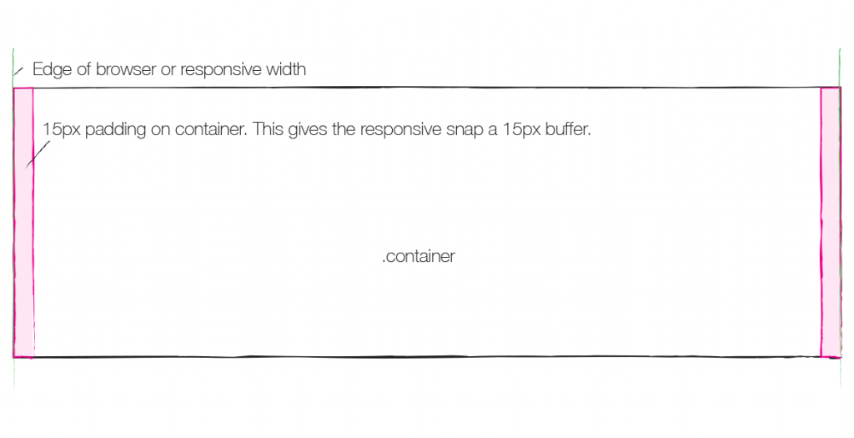
Bootstrap 2
Rules of the Rows

Slide 12
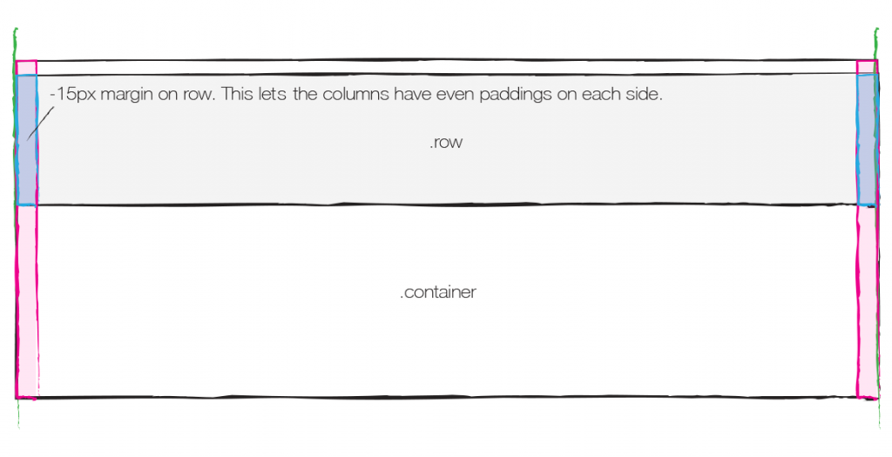
Bootstrap 2
Rules of the Rows

Slide 13
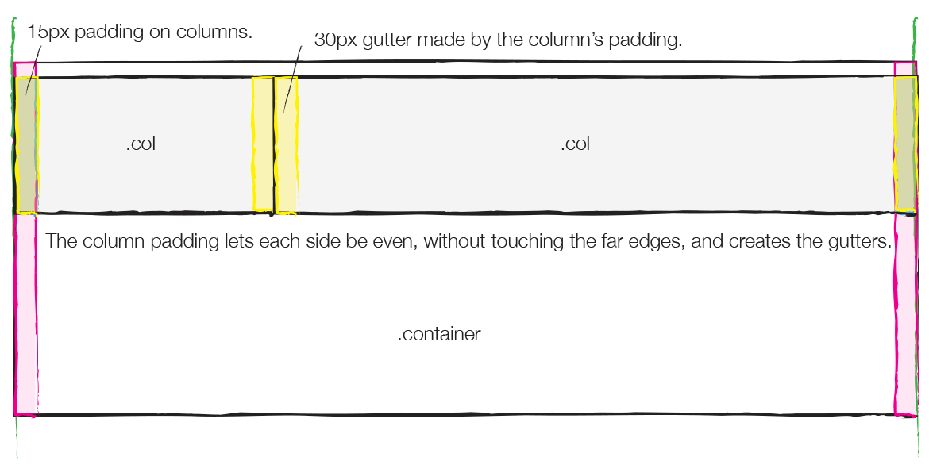
Bootstrap 2
Rules of the Rows

Slide 14
Bootstrap 2
Columns
col creates equal sized columns equal to the 12 total in the row
col-4 creates 3 equal sized columns equal to the 12 total in the row.
col-6 creates 2 equal sized columns equal to the 12 total in the row.
Have utility classes to specify size of the column or number of columns to span at each breakpoint or screen size. The total must equal 12 col-sm-4
To Access Grid Layouts go to:
https://getbootstrap.com/docs/4.3/layout/grid/

Slide 15
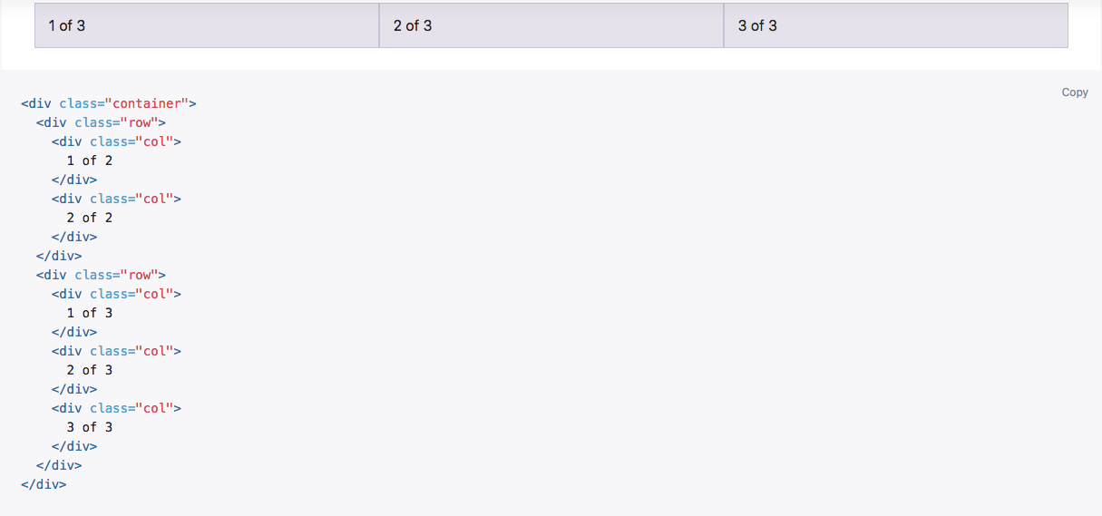
Bootstrap 2
Bootstrap Sample Grid
col makes all of them equal size
Can use divs or sections and articles

Slide 16

Bootstrap 2
Columns
To Access Grid Layouts go to:
https://getbootstrap.com/docs/4.3/layout/grid/

Slide 17
Bootstrap 2
In Class Exercise
Download and save the enhanced_start.html file and images folder and save it to the public_html/class-samples/ folder on your computer.
Download the images and save it to the public_html/class-samples/images folder on your computer.
Open the enhanced_start.html file in brackets.
Add a <div> with the class container for your main container.
Add a <section> with the class row and 3 <article> columns with class col to the page inside the container element. Make them equal size.
Add comments around the main container and the new row
Add the About, Expert Speakers, and What You’ll Learn text into the columns from the file sent to you "text for the PBCS Conf page"

Slide 18
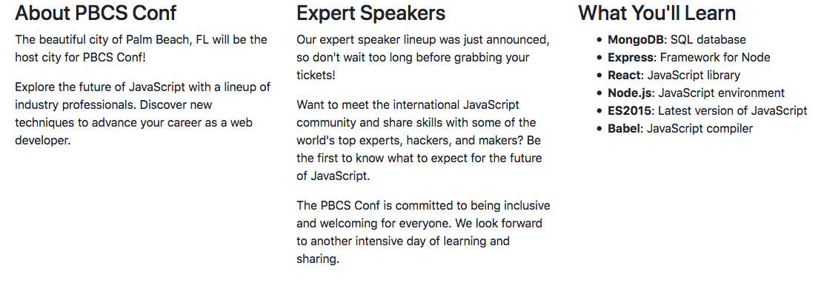
Bootstrap 2
In Class Exercise

Slide 19
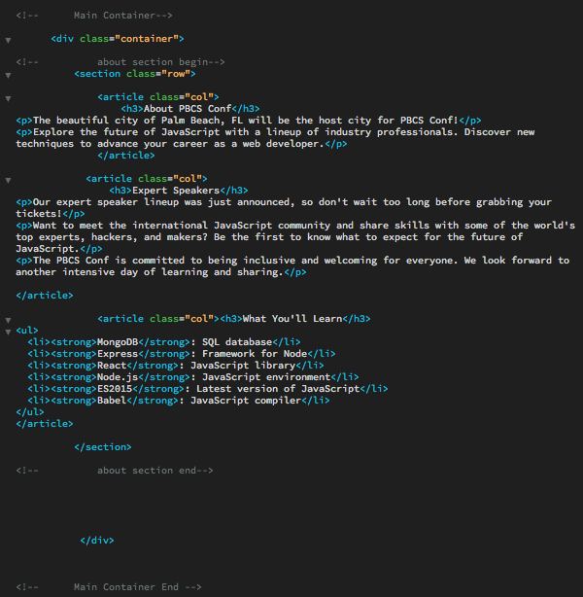
Bootstrap 2

Slide 20
Bootstrap Spacing & Grids

Slide 21
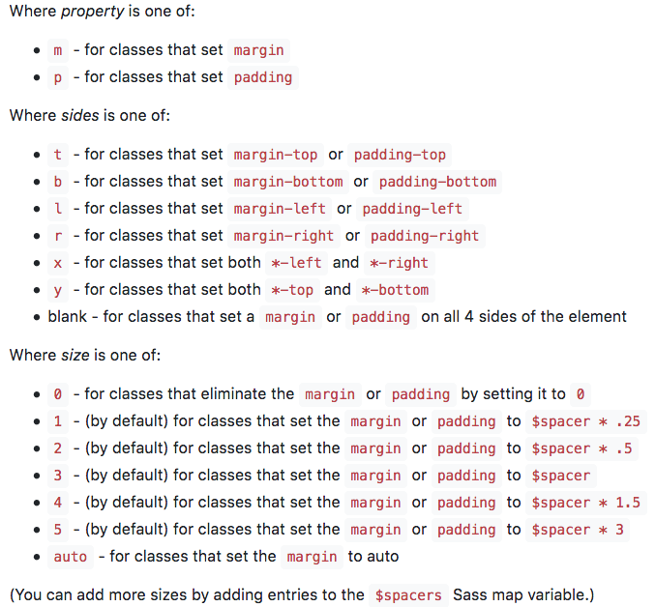
Bootstrap 2
Spacing and Grids
The spacing utilities can be combined with with grid or other elements to space items.

Slide 22
Bootstrap 2
Spacing and Grids
Margin and Padding Classes
Use the margin and padding spacing utilities to control how elements and components are spaced and sized.
Bootstrap 4 includes a five-level scale for spacing utilities, based on a 1rem value default $spacer variable. Choose values for all viewports (e.g., .mr-3 for margin-right: 1rem), or pick responsive variants to target specific viewports (e.g., .mr-md-3 for margin-right: 1rem starting at the md medium breakpoint)
Spacing shorthand mx (left and right) and my (top and bottom) will give you spacing on sides based on x and y. For all 4 sides use just m
https://getbootstrap.com/docs/4.3/utilities/spacing/

Slide 23
Bootstrap 2
Spacing and Grids
In class exercise continued:
Space the main container element item from the top using padding pt-4
Space each of the <h3> elements on the bottom by adding a class and using margin the mb-4 classname
Add the pdx.jpg image to the about column below the <h3> and add a class for margin to the bottom of the image using margin class" mb-4

Slide 24

Bootstrap 2
Spacing and Grids

Slide 25
Bootstrap 2
Modifying Images and Making Them Responsive
Responsive images
Images in Bootstrap are made responsive with img-fluid max-width: 100%; and height: auto; are applied to the image so that it scales with the parent element or container it is in / scales with the column using this class. https://getbootstrap.com/docs/4.3/content/images/
Can also combine with border and radius utility class to create effects on images
https://getbootstrap.com/docs/4.3/utilities/borders/
Borders: border
Colors: border -primary -secondary -success -danger -warning -info
Radius
rounded
rounded -top - bottom -right -left -circle

Slide 26
Bootstrap 2
Customizing and Styling Headings and Typography
Fancy display heading <h3 class="text-muted">With faded secondary text</h3>
Display headings (used in last class)
<h3 class="display-4">Text Stands Out</h3>
Traditional heading elements are designed to work best in the meat of your page content. When you need a heading to stand out, consider using a display-4 heading—a larger, slightly more opinionated heading style.
Center, right , left (center used in last class)
<h3 class="text-center">Text Stands Out</h3>
Make type/text align text-center
Lead (used in last class)
<p class="lead">Paragraph Stands Out</p>
Make a paragraph stand out by adding the class lead

Slide 27
Bootstrap 2
In class exercise continued:
Make the image responsive using img-fluid class to the img tag and make it size to the column
Add the rounded radius class to the image to round the corners
Space the image on the bottom using the mb-4 margin spacing class
Add a two new headings from the file sent to you "text for the PBCS Conf page" below the about section <!--speakers--> <!--schedules--> above the close for the main container.
Add the display heading utility class to the <h1> on the speakers and schedules text using 4 for the size i.e. class="display-4"
Center align the speaker and schedule headings using the text-center utility class in the <h1>
Space the headings using the shorthand spacing utility class m and y to add padding to the top and bottom of the sections. (use 5 for the size) class="my-5"
Add a fancy text fade to each of the headings <h1> using text-muted heading content typography class

Slide 28
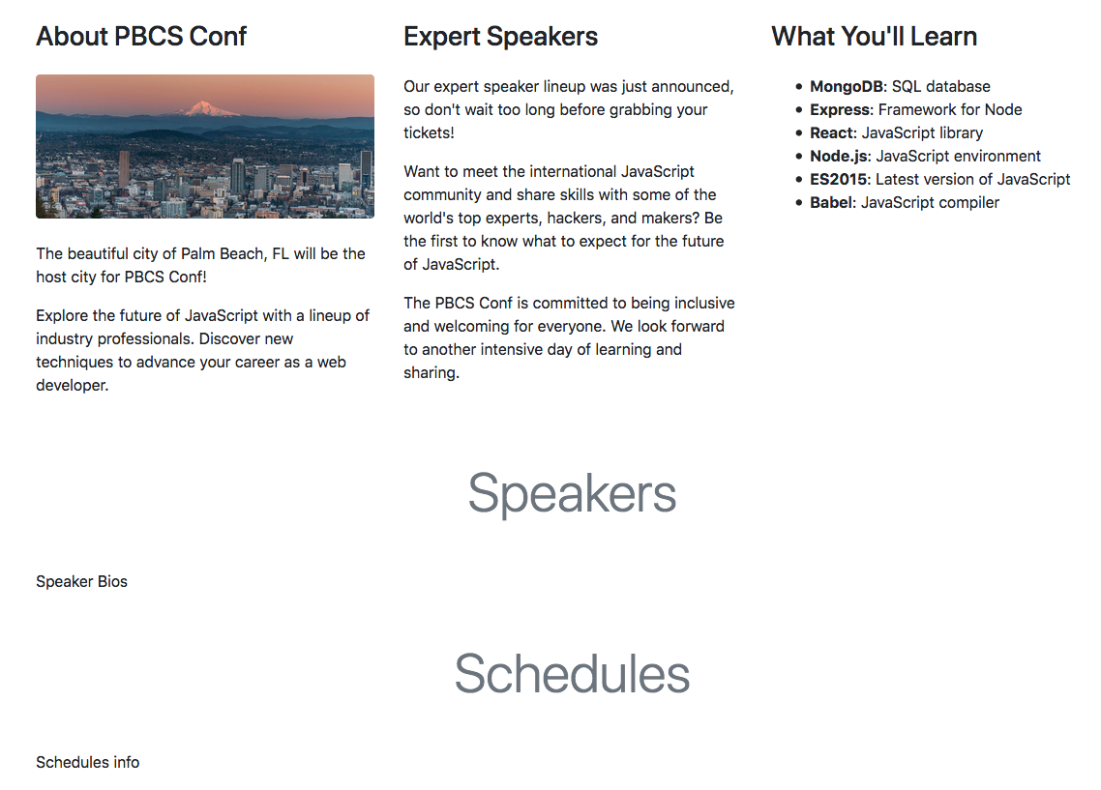
Bootstrap 2
Image and Text Changes

Slide 29
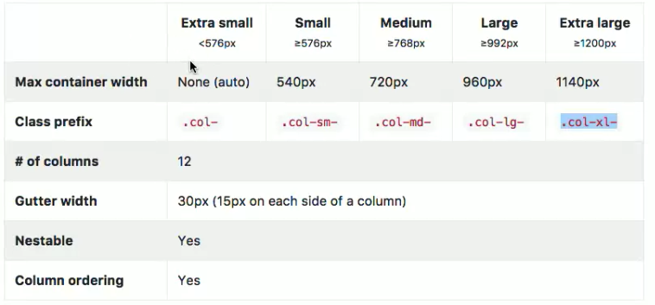
Bootstrap 2
Classes Across Each Device

Slide 30
Bootstrap 2
Modifying Columns Based On Viewport Range
Setting columns using the bootstrap grid or col class will scale the columns equally as you resize but not stack them
You don’t have to add a column width at every breakpoint
You set the stacking based on the breakpoints or screen size you want to stack the items for.
The col-sm class would stack items only in the extra small range or anything below 576px.
The col-md class would stack items in the extra small and small or anything below 768px.
If you set the breakpoint to col-lg it would stack on extra small, small, and medium breakpoints or screens

Slide 31
Bootstrap 2
Modifying Columns Based On Screen Size
Can also set the size of each box based on the breakpoint using a number. The box size would be based on the 12 grid system class="col-sm-6" if you set the box size to one column the others will take up the rest of the grid and resize around it.
Can also have multiple grid classes for a column by adding a number at each breakpoint class="col-lg-6" applies 6 grid spaces to the large viewport for the column you place it in making the column you assign it to larger in the extra large viewport
Can also set grid or columns at multiple breakpoints. Used if you wanted to eliminate white space or change layout for each device type
class="col-lg-6 col-sm-6"

Slide 32
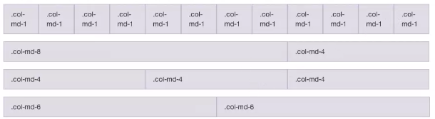
Bootstrap 2
Must total 12 Columns Per Page & Depends on Viewport

Slide 33

Bootstrap 2
Adding additional rows and columns to a page:
Can have up to 12 columns in a grid depending on viewport
You can calculate the column based on your need and or parts. The row will float each column next to one another
Columns can be defined based on each breakpoint col- col-sm- col-md- col-lg- col-xl- with column count or number
https://getbootstrap.com/docs/4.3/layout/grid/#responsive-classes

Slide 34


Bootstrap 2
Sample Column Layout
Large Screen Medium Screen Small Screen

Slide 35
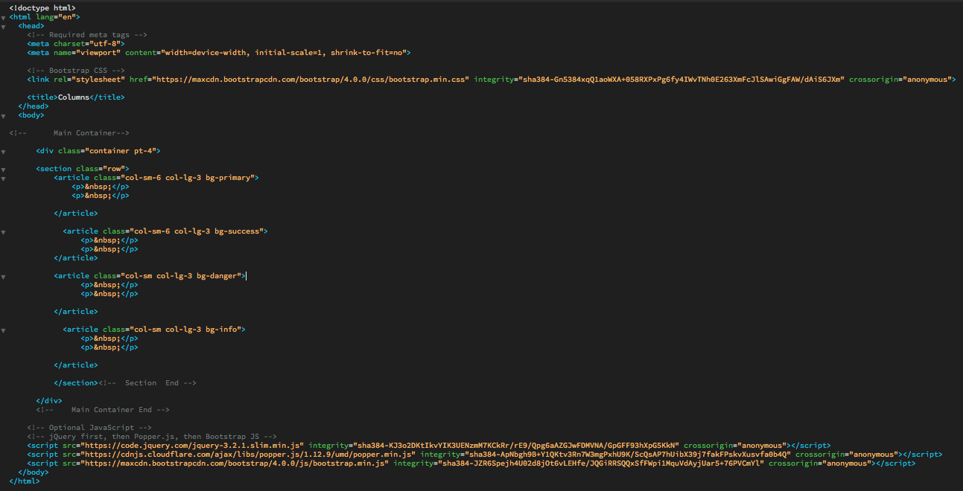
Bootstrap 2
Sample Column Layout

Slide 36
Bootstrap 2
Bootstrap Grid Help
http://www.helloerik.com/the-subtle-magic-behind-why-the-bootstrap-3-grid-works
https://medium.com/@erik_flowers/how-youve-been-getting-the-bootstrap-grid-all-wrong-and-how-to-fix-it-6d97b920aa40

Slide 37
Bootstrap Arranging Content

Slide 38
Bootstrap 2
Reordering Content Based on Breakpoint or Device Type
Order classes
Use order- classes for controlling the visual order of your content or column. These classes are responsive, so you can set the order by breakpoint (e.g., order-1 order-md-2). Includes support for 1 through 12 across all five grid tiers.
Note if you use the class= "order" at a certain breakpoint the other columns in the row would need the other numbers defined to set the order
Column 1 class= "col-lg order-lg-1"
Column 2 class= "col-lg order-lg-2"
Column 3 class= "col-lg order-lg-3"
https://getbootstrap.com/docs/4.3/layout/grid/#order-classes

Slide 39
Bootstrap 2
In class main section exercise continued:
Add the large column utility class to each of the 3 columns class= "col-lg" making it collapse at the medium, small and extra small breakpoints.
Order the about column to be in the middle of the page for the (large, and extra-large viewports)using the order utility class class= "col-lg order-lg-2 About should stack on top beginning at medium breakpoint
Add add additional column values to order the other two columns
Add class= "col-lg order-lg-1" to Expert Speakers
Add class= "col-lg order-lg-3" to What You’ll Learn

Slide 40
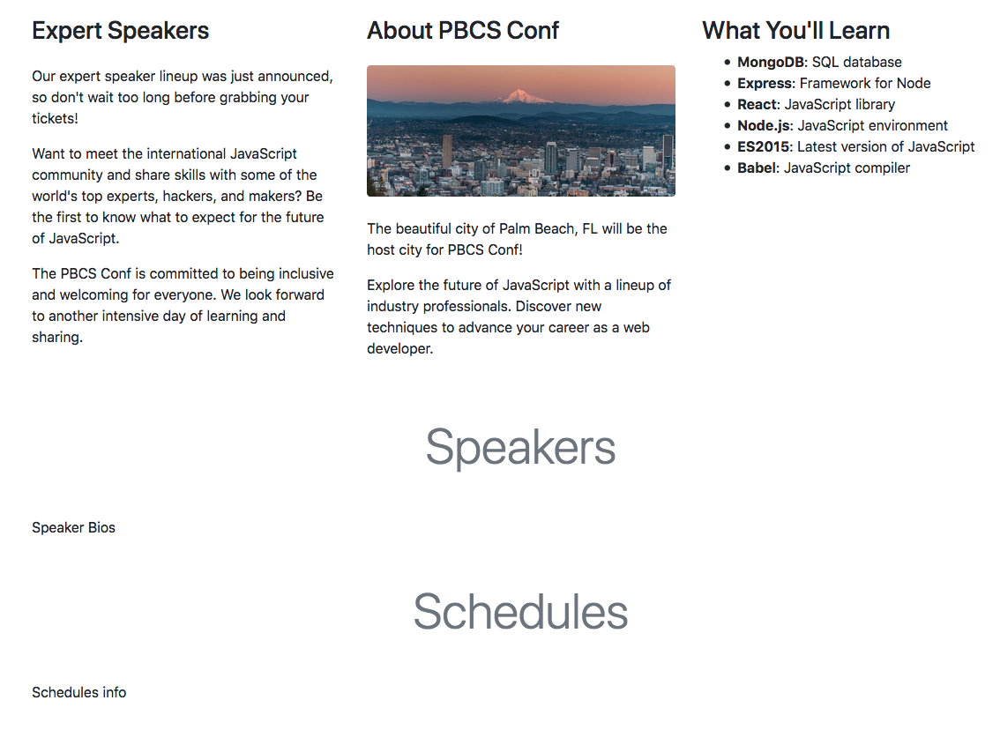
Bootstrap 2

Slide 41
Bootstrap 2
Offsetting or spacing columns
You can offset grid columns in two ways: our responsive offset- grid classes and our margin utilities. Grid classes are sized to match columns while margins are more useful for quick layouts where the width of the offset is variable.
Offset classes
Move columns to the right using offset-md-* classes. These classes increase the left margin of a column by * columns. For example, offset-md-4 moves col-md-4 over four columns.
ml.auto sets auto margin on the left of the column forcing others away from them
Used to push columns over to the right for spacing
Increases the left margin of a column by # columns
col-md-4 col-xs-offset-4 -Would offset 4 columns totaling the 12 columns in the grid
col-xs-offset-# col-xs-ml-auto
col-sm-offset-#
col-md-offset-#
col-lg-offset-# https://getbootstrap.com/docs/4.3/layout/grid/#offsetting-columns

Slide 42
Bootstrap 2
Responsive Display/Hide Utility Classes (faster display less data)
Used to hide or show items like images or sections of pages when switching to certain viewport breaks
The display property class accepts a handful of values and we support many of them with utility classes. They purposefully don’t provide every value as a utility, so here’s what they support:
d-none hides at the extra small breakpoint and up
d-inline
d-inline-block
d-block shows at the extra small breakpoint and above
d-table
d-table-cell
d-flex
d-inline-flex
Put them to use by applying any of the classes to an element of your choice. You can also add the md, sm, lg to the d-block to make it show at various breakpoints
https://getbootstrap.com/docs/4.3/utilities/display/

Slide 43
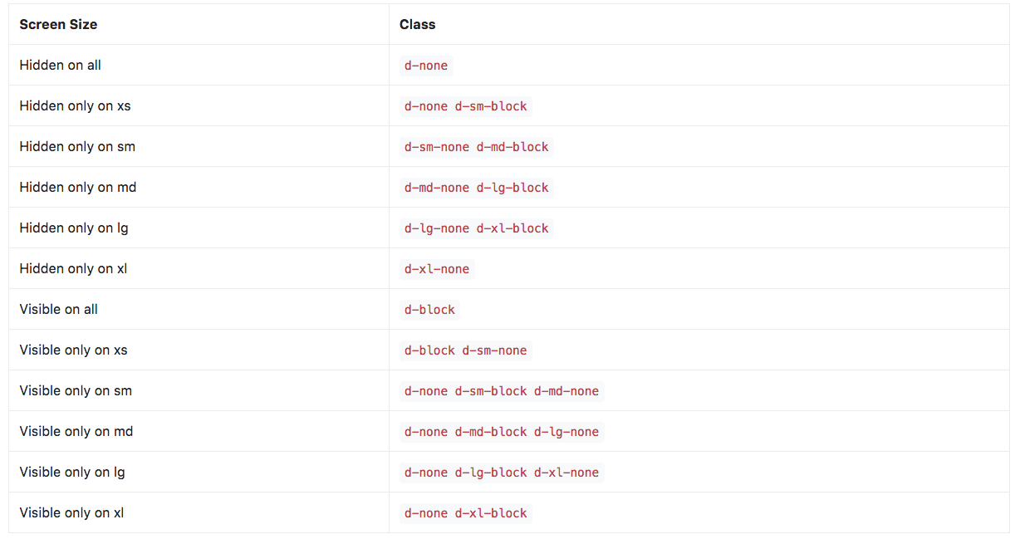
Bootstrap 2
Responsive Display Utility Classes (faster display less data)
https://getbootstrap.com/docs/4.3/utilities/display/#hiding-elements

Slide 44
Bootstrap 2
In class signup form exercise continued:
Add the signup form from the "text for pbcs text document sent" to the page, below the schedule end comment and above the end of the main container div. All code provided for the remaining exercises can be obtained from the Bootstrap website code snippets if you wanted to modify or change the look.
Make each of the sign up columns span 5 on the extra large viewport class="col-md col-xl-5"
Make the stay up to date column offset or move to the right with a margin left auto utility class - class="col-md col-xl-5 ml-auto" this will accommodate the last two columns in the grid from the 10 and gives space between the two columns in the extra large viewport
Hide the image in the about section of the page by adding the d-none class to the image class="img-fluid rounded d-none" this will hide it at the extra small breakpoint and above
Show the image in the small to extra large viewport using the class d-block class="img-fluid rounded d-none d-sm-block"

Slide 45

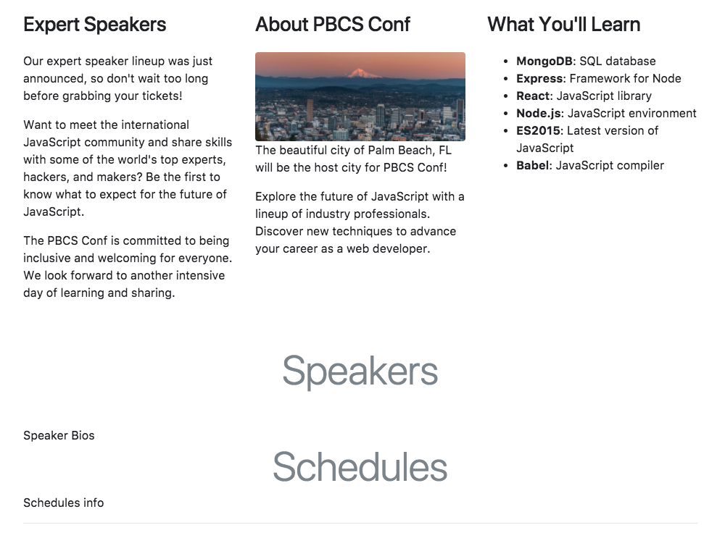
Bootstrap 2
Modifying, Adding, Re-Ordering and Visibility
XSM Viewport SM-LG Viewport

Slide 46
Bootstrap Interactive
Components

Slide 47
Bootstrap 2
Navigation and Navbar Components
Base Nav
Navigation available in Bootstrap share general markup and styles, from the base nav class to the active and disabled states. Swap modifier classes to switch between each style.
https://getbootstrap.com/docs/4.3/components/navs/
The base nav component is built with flexbox and provide a strong foundation for building all types of navigation components. It includes some style overrides (for working with lists), some link padding for larger hit areas, and basic disabled styling.
The base nav component does not include any active state. The examples include the class, mainly to demonstrate that this particular class does not trigger any special styling.
The base nav component also contains nav-items which are links for the navigation

Slide 48
Bootstrap 2
Navbar Component
navbar class sets up the navbar and is a wrapper for its contents to hold, customize and position items like
Brand/Logo
Header
Color
Search box or form elements
Collapses and toggles the menu/nav in different device types
Uses either a list or nested links depending on type you choose
Placing the navbar outside the main container will allow it to stretch across the whole page
https://getbootstrap.com/docs/4.3/components/navbar/

Slide 49
Bootstrap 2
Navbar Components (Helper or Utility Classes)
navbar class sets up the navbar
Alignment utility class can align items (Horizontal, Vertical) justify-content-center
Tabs or pills on the navbar can be created using utility classes nav-tab and nav-pills
navbar-brand class is used for company name or project title
navbar-toggler-icon class uses a span element to give users an indicator that it is a dropdown at the sm and xs breakpoints.
navbar-toggler shows and hides the nav at the sm and xs breakpoints.
The active and disabled classes are used to set the link focus to a specific nav link you are navigating to or to show the link as grayed / disabled
The navbar-dark or navbar.light class change the color depth of the navbar
The bg-primary or utility class colors as well as style= "background-color: color Hex value" classes/CSS give it color
The fixed-top or fixed-bottom class freezes the navbar at the top so the page content scrolls under or behind it
https://getbootstrap.com/docs/4.3/components/navbar/
http://getbootstrap.com/docs/4.3/components/navs/#horizontal-alignment
http://getbootstrap.com/docs/4.3/components/navs/#tabs

Slide 50
Bootstrap 2
In Class Navbar Assignment:
In the enhanced_start.html file add the text titled <!--Navbar Start--> and <!--Navbar End--> from the text for PBCS conf page file and paste it into the page just below the <body> tag and outside of the main container comment. The Navbar will fit the whole page
Remove the active and disabled utility classes from the navbar nav-link items <a tag>
Move the navbar-brand to the right side of the navbar using the order-1 class
Change the background color of the navbar to dark with color primary (blue) using navbar-dark and bg-primary classes instead of existing classes navbar-light and bg-light
Add a container div <div class= “container”> around the navbar just above the <a class="navbar-brand order-1" href="http://www.palmbeachcodeschool.com" target="_blank">PBCS Presents</a> and closing container just above </nav>to center/align "the navigation only" above the content of the page
Add a margin right of 0 to the navbar-brand using the mr-0 class so the title / brand aligns with right side of the outer container, which makes it flush with the right of the content
Make the navbar fixed using the utility class fixed-top so it stays at the top of the page and the contents scrolls behind it <nav class="navbar navbar-expand-lg navbar-dark bg-primary fixed-top">

Slide 51
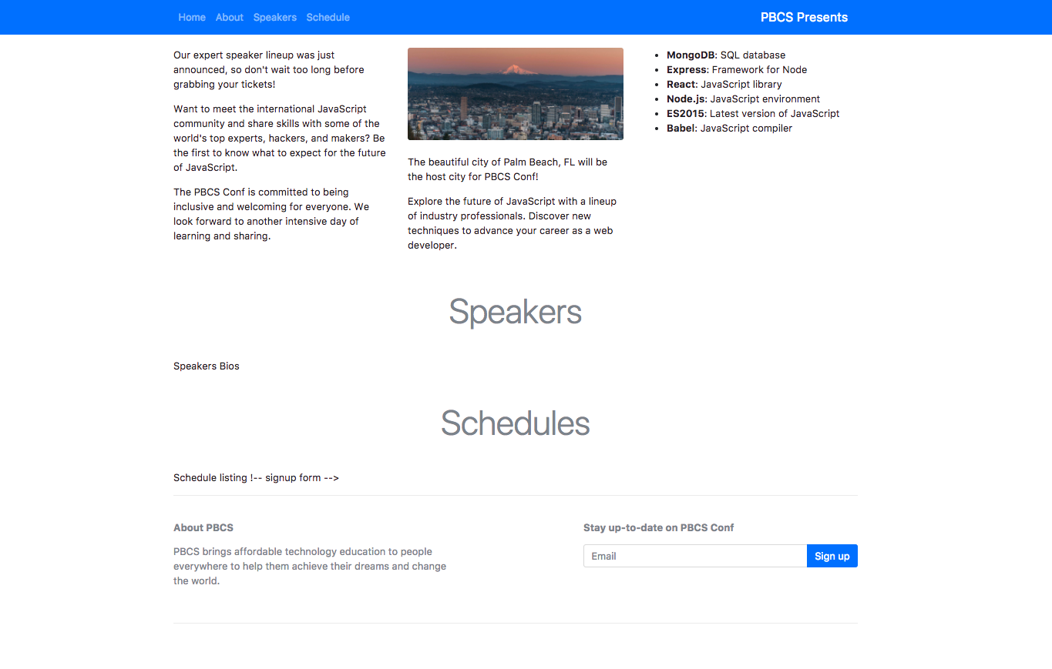
Bootstrap 2

Slide 52
Bootstrap Interactive
Components

Slide 53
Bootstrap 2
Bootstrap Jumbotron Component
Jumbotron is like a banner - Used to showcase major content or sections of the page and highlights any call to actions for users:
Jumbotron Class:
class="jumbotron" (main box around content)
class=" jumbotron jumbotron-fluid" (main box around content spans whole page)
Can use Utility Classes, Headings or Paragraphs to add emphasis and style:
Additional CSS that can format a heading (display) <h1 class="display-2"> makes it appear large in viewport
Additional CSS that can format paragraphs and set as main paragraph with formatting (lead) <p class="lead"> also makes it appear smaller in viewport

Slide 54
Bootstrap 2
In Class Jumbotron Assignment:
Copy the text titled <!--Jumbotron Start -->and <!--Jumbotron End--> from the text for PBCS conf page file and paste it into the page into the enhanced_start.html file below the <!--Navbar end--> tag and outside of the container.
Change the display class in the<h1> inside the div that says PBCS CONF and give it a display-2
Color the jumbotron with the bg-info and color the text white using the utility class text-white in the jumbotron div
Center the text in the small viewport using the text-sm-center utility class in the container div below the jumbotron div <div class="jumbotron jumbotron-fluid bg-info text-white ">
Add padding to the top of the jumbotron using the utility class pt-5 in the container
<div class="container text-sm-center pt-5">

Slide 55
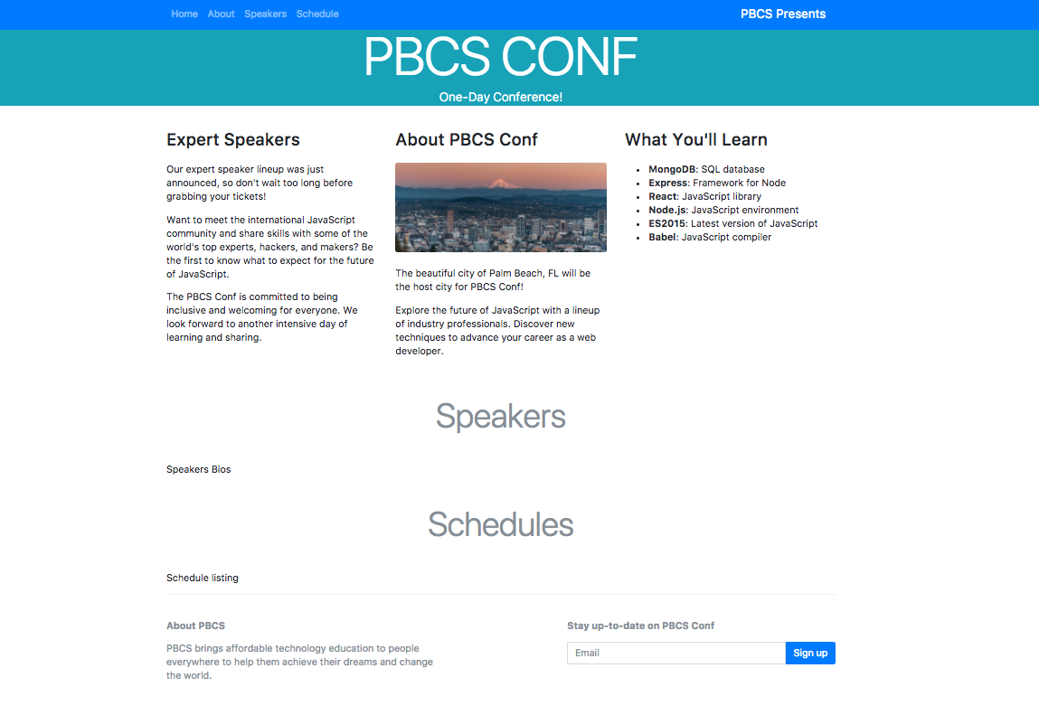
Bootstrap 2

Slide 56
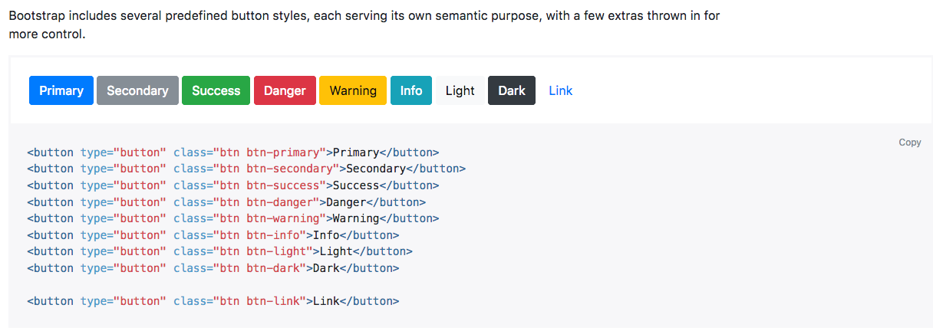
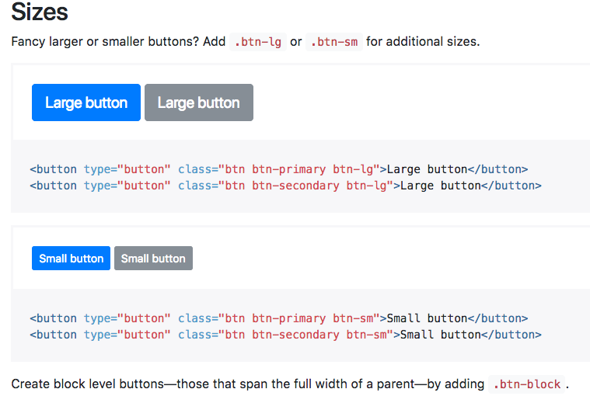
Bootstrap 2
Buttons
Bootstrap has 9 button states which include a hover
Buttons can be used as anchors by changing them to href
<a class= "btn btn-light btn-lg" href= "...">See Speakers</a>
http://getbootstrap.com/docs/4.3/components/buttons/

Slide 57
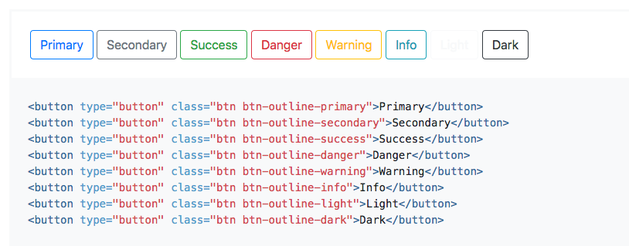
Bootstrap 2
Buttons
Link/Button Classes- sets up the content:
Buttons can be Single, Split, Dropdown buttons.
Buttons can be sized, or color can be modified using utility class
class="btn "
Button Utility Classes -add color, size, and style:
Button Utility Classes can be set like (primary, default, success, info , warning, danger)(large small medium)
class="btn btn-success" these classes can be placed directly in the quotes as a second class
Can also be used as a link by adding <a class="btn btn-lg btn-success" href="#">Link</a>
Outline buttons .btn-outline removes all background images and colors on any button.

Slide 58
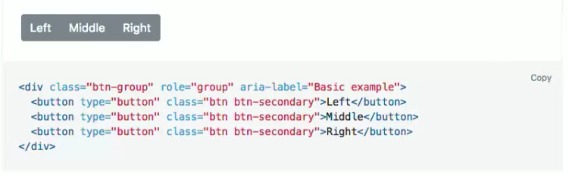
Bootstrap 2
Button Groups
Buttons can be grouped as a series of buttons together on a single line with the button group, and super-power them with JavaScript.
http://getbootstrap.com/docs/4.3/components/button-group/

Slide 59
Bootstrap 2
In Class Button and Jumbotron Buttons Assignment:
Copy and paste text from text for PBCS page titled <!--Buttons Start--> and <!--Buttons End--> into the enhanced_start.html file just below the <!--Schedule end--> comment tag but above <!--sign up form-->
Change to button from btn-secondary to large outline button using class= "btn btn-outline-info btn-lg"
Set the buttons display value to block to move it to the next line to separate it from the text using d-block class inside the button or <button class= " btn btn-outline-primary btn-lg d-block">
Center the button using the left right margin or mx-auto margin class and add it to the button class
Add margin to the top of the button using the margin short hand class my-5 learned earlier
Add text from text for PBCS page titled <!--Jumbotron Buttons Start--> and <!--Jumbotron Buttons End--> into the jumbotron just below paragraph "One- Day Conference.." the btn-group utility class groups the buttons on a single line <div class= "btn-group">
Add a margin spacing to the top of the button group div using the margin utility class mt-4
Change the aria-label to say Action Buttons used to make more accessible to people with disabilities.
Make the Register button blue instead of gray and the See Speakers button light instead of gray using the utility classes btn-primary and btn-light
Make the See Speakers button an anchor instead of button and link the href to #speakers section by changing the <button></button> to an anchor or <a class= "btn btn-light" href= "#speakers">See Speakers</a>
Delete the type="button" from the anchor and make the button large by adding the btn-lg utility class
Link the button within the page to the Speakers section by adding an id= "speakers" to the <h1> in the Speakers section in the page

Slide 60
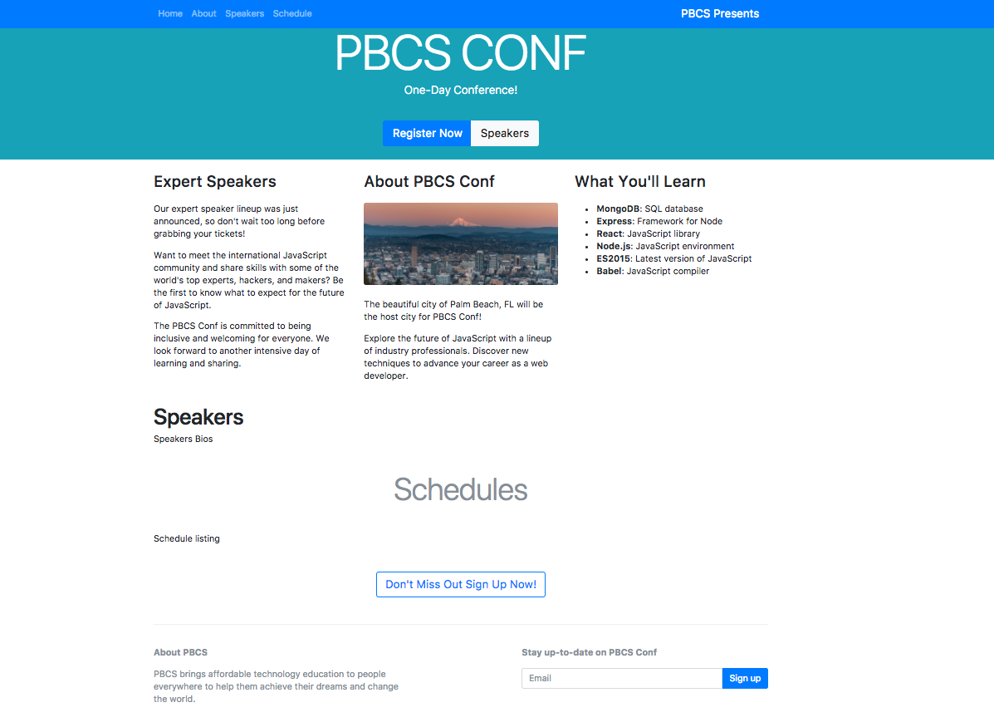
Bootstrap 2

Slide 61
Bootstrap 2
Navigation and Dropdowns
Dropdowns are toggleable, contextual overlays for displaying lists of links and more
Can be used in a navbar or as a footer navigation
Uses jQuery and JS library files (at the bottom of the page above </body>)
Can make a button a dropdown single or split button (has a toggle)
Fully Responsive
Uses bootstrap classes:
dropdown class on a surrounding <div>
dropdown-menu class on a list item <li>
Used in combination with dropdown-toggle to create the open and close state of the dropdown.
Similarly, you can create split button dropdowns with virtually the same markup as single button dropdowns, dropdown-toggle-split but with the addition of dropdown-toggle-split for proper spacing around the dropdown caret icon.
NOTE: Accessible Rich Internet Applications (ARIA) defines ways to make Web content and Web applications (especially those developed with Ajax and JavaScript) more accessible to people with disabilities.

Slide 62
Bootstrap 2
Navigation and Dropdowns
dropdown-item class on a surrounding <a class= "dropdown-item">My Link</a>
dropdown-divider Creates a horizontal line between sections of dropdown items
Can create drop ups or make the menu appear above using the dropup utility class inside your button group which will make the arrow point up and dropdown items appear above the dropdown
http://getbootstrap.com/docs/4.3/components/dropdowns/

Slide 63
Bootstrap 2
In Class Dropdowns Assignment:
Add the <!--footer start --><!footer end --> text from the PBCS conf text document and paste it above the main container’s closing </div> <!--Main Container End--> that ends the overall container and just below the <!--/signup form -->
This uses the base nav similar to what we used for our navbar earlier
Remove the active class from the first list item link. Pagination links are customizable for different circumstances. Use disabled for links that appear un-clickable and active to indicate the current page.
<a class="nav-link active" href= "#"> Community </a>
Copy the split dropdown text from the PBCS conf text document then paste it inside the <li class="nav-item"> </li> replacing the <a class="nav-link" href= "#"> Other Confs </a> anchor tag. This uses built-in Javascript to create the split dropdown
Change the text/menu items for each dropdown item to : HTML 5, CSS, and Javascript (instead of Action Another Action, Something Else Here) for other dropdown menu items
Remove the line divider that divides the two dropdowns <div class="dropdown-divider"></div>
Remove the <a class dropdown-item href= "#"> Separated link</a> spacer

Slide 64
Bootstrap 2
In Class Dropdowns Assignment:
Change the Button text or name from Action to Other Confs <button type="button" class="btn btn-outline-secondary">Action</button> Change the Action to Other Confs
Change the button colors from danger to outlined gray or btn-outline-secondary just below <div class="btn-group"> <button type="button" class="btn btn-outline-secondary">Action</button>
<button type="button" class="btn btn-outline-secondary dropdown-toggle dropdown-toggle-split" data-toggle="dropdown" aria-haspopup="true" aria-expanded="false">
Make the arrow point up instead of down by adding the dropup utility class to the btn-group div just below <!--Split Dropdown --> menu displays above since the dropdown is at the bottom of the page
<!-- Split Dropdown -->
<div class="btn-group dropup">

Slide 65
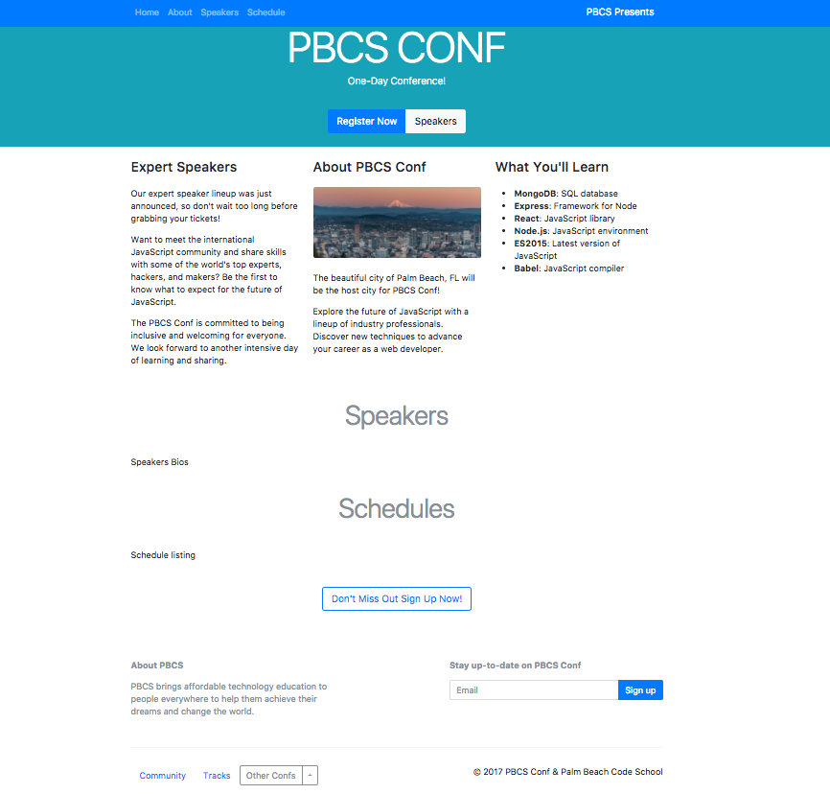
Bootstrap 2

Slide 66
Bootstrap 2
Adding Cards
Used For (Images Headings, List Groups)
A card is a flexible and extensible content container. It includes options for headers and footers, a wide variety of content, contextual background colors, and powerful display options.
Cards replace old Bootstrap 3 panels, wells, and thumbnails. Similar functionality to those components is available as modifier or utility classes for cards.
Cards can also be grouped, spaced as decks, or columns using utility classes card-group card-deck card-columns
Each card has its own set of sections http://getbootstrap.com/docs/4.3/components/card/#image-caps
Body
Title
Text
Reminder Note: if you have more than 12 columns listed in a row the extra columns will wrap to the next line
http://getbootstrap.com/docs/4.3/components/card/

Slide 67
Bootstrap 2
In Class Card Assignment:
Add the speakers cards text <!-- Speakers Cards Start--> <!-- Speakers Cards end-->from the PBCS conf text document and paste where the speakers bios text is
From the PBCS conf text document add the <!-- Image Caption--> <!-- Image Caption End -->to each column div <div class="col-md-6"></div>
Add the images provided to each card where the <img class= "card-img-top" src=".../100px100" alt="Card Image Cap"> replacing the other location .../100px100 with the person’s picture (Vivianne, Nodestra, Robbie, Ecma,Jay Q, Json)
Add the speakers <h1> heading and <p> paragraph from the PBCS Conf text document to each image caption starting with Vivianne into the div replacing the <h5 class="card-title">Card Title</h5> and <p class= "card-text">The wider…</p> Finish the other columns following the same process (Vivianne, Nodestra, Robbie, Ecma,Jay Q, Json)
Add a column breakpoint to all the column divs at the large screen size to display 3 speakers per line in large to xl screens col-lg-4 or <div class= "col-md-6 col-lg-4"> </div> the col-md-6 will show 2 speakers per line in medium screens and 1 speaker per line in small xsmall screens

Slide 68
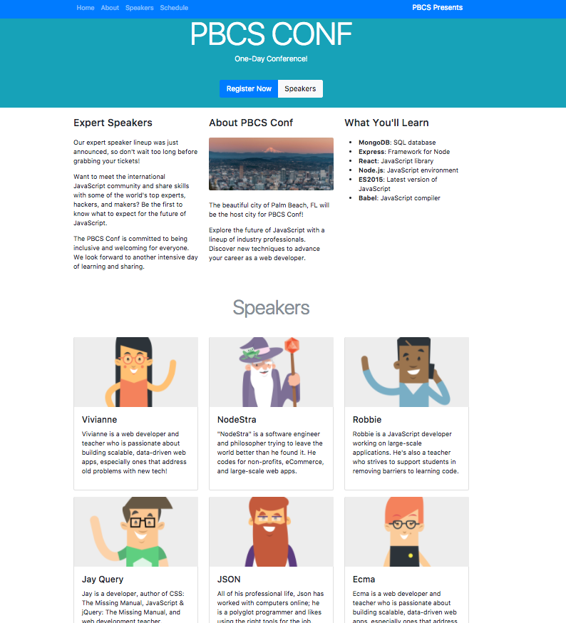
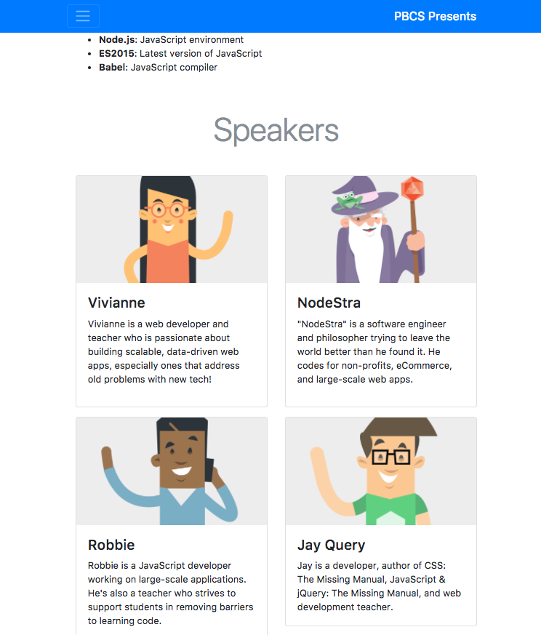
Bootstrap 2
LG Viewport
MD-SM Viewport

Slide 69
Bootstrap 2
List Groups
http://getbootstrap.com/docs/4.3/components/card/#list-groups
Create lists of content and for displaying a series of content (make them pretty)
Uses two classes list-group for the list and list-group-item for the list items
Can/should be wrapped with a <div></div> inside the <li></li> with a utility class= "d-flex justify-content-between" the div will be a flex container and help align everything. D-flex enables flex behavior
Use justify-content utilities on flexbox containers to change the alignment of flex items on the main axis (the x-axis to start, y-axis if flex-direction: column). Choose from options (start (the browser default) end center between or around). The justify-content-between equally distributes the content on a single line
Can style the list item with list-item-success list-item-primary utility classes within the list item group
Can be linked to sections of the pages

Slide 70
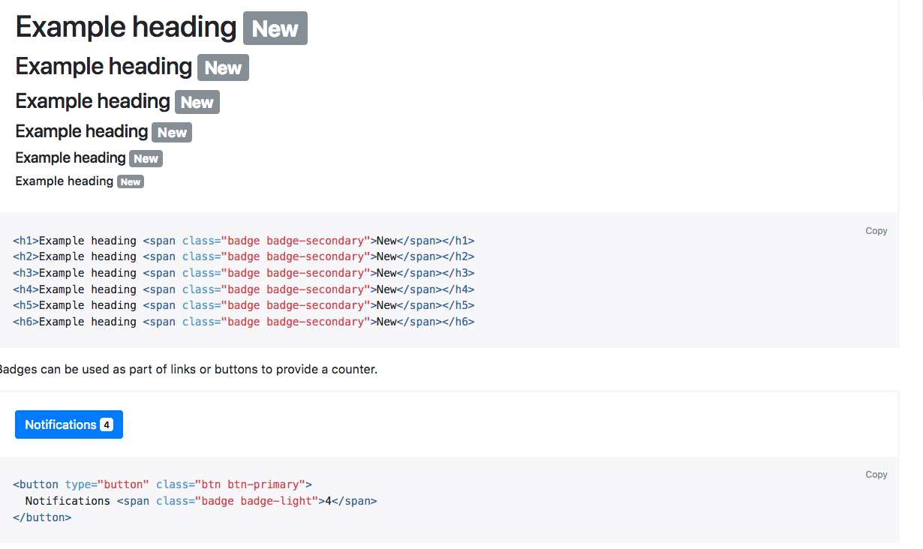
Bootstrap 2
Badges
https://getbootstrap.com/docs/4.3/components/badge/
Badges scale to match the size of the immediate parent element by using relative font sizing and em units. (contextual, pill, and links)
Badges can be used as part of links or buttons to provide a counter.

Slide 71
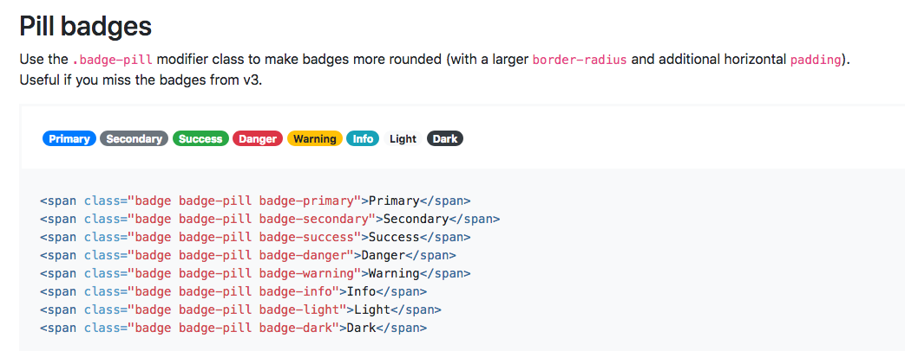
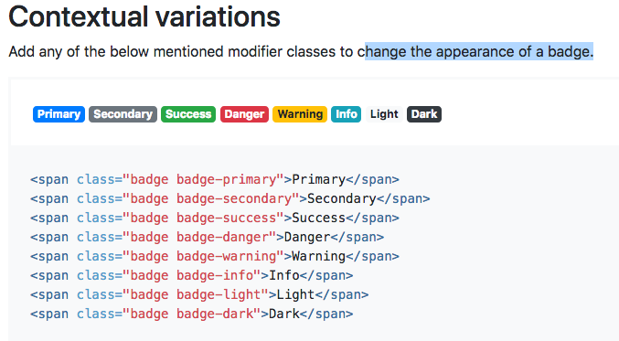
Bootstrap 2
Contextual Classes or Variations
http://getbootstrap.com/docs/4.3/components/list-group/#contextual-classes
To change the appearance of a badge. For a rounded shape use badge-pill and to add a color use something like badge-primary
<span class= "badge badge-pill">highlighted item </span>

Slide 72
Bootstrap 2
In Class List Group Assignment:
Add the list group text from the text for pbcs text file into the <article> just below the <h3 class= "mb-4" >What You’ll Learn</h3> and just above the </article> replacing the existing unordered list <ul></ul>
Add the schedules unordered list text from the text for pbcs text file replacing <!--Schedules--> <!--Schedules End --> section created earlier
Add a class= "d-flex justify-content-between" into the <div></div> inside the <li class= "list-group-item"></li> this will help align the first item to the left side and the other element to the right of the list
Add a heading <h5 class="mb-1"> </h5> with a margin bottom of 1 mb-1 inside the <div> starting with the text from pbcs text file Keynote: Internet Things <h5 class="mb5">Keynote: Internet Things</h5>
Add a Pill Badge using a <span></span> and the utility class badge-pill <span class= " badge badge-pill badge-info p-2"></span> copy the text from pbcs text file and paste below the <h5> heading above the </li>then add the text of 9:00AM from pbcs text file to the or <span class= " badge badge-pill badge-info p-2"></span> replacing the text Info
Add a paragraph and a margin of 1 <p class="mb-1"> containing the speaker name Nostra from pbcs text file and paste below/outside of the the </div> or <p class="mb-1">Nostra</p>

Slide 73
Bootstrap 2
In Class List Group Assignment:
Copy the entire list group item just created <li class="list-group-item">
<div class="d-flex justify-content-between">
<h5 class="mb-1"> Keynote Internet Things</h5>
<span class="badge badge-pill badge-info p-2">9:00AM</span>
</div>
<p class="mb-1">Nodestra</p>
</li>
and paste it 3 more times inside or above the </ul>
Make the schedule times badges 10:00 , 11:00 , 12:00PM <span class="badge badge-pill badge-info p-2">9:00AM</span>
Change the headings <h5> for each heading to HTML5 , Javascript and Lunch <h5 class="mb5">Keynote: Internet Things</h5>
Change the speaker names for each <p class="mb-1">Nostra</p> to Vivianne, JQuery and Free Pizza
Style the lunch list group list item with a success using the list item contextual class add it just below the <ul class="list-group">and inside the <li> should look like <li class="list-group-item list-group-item-success">

Slide 74
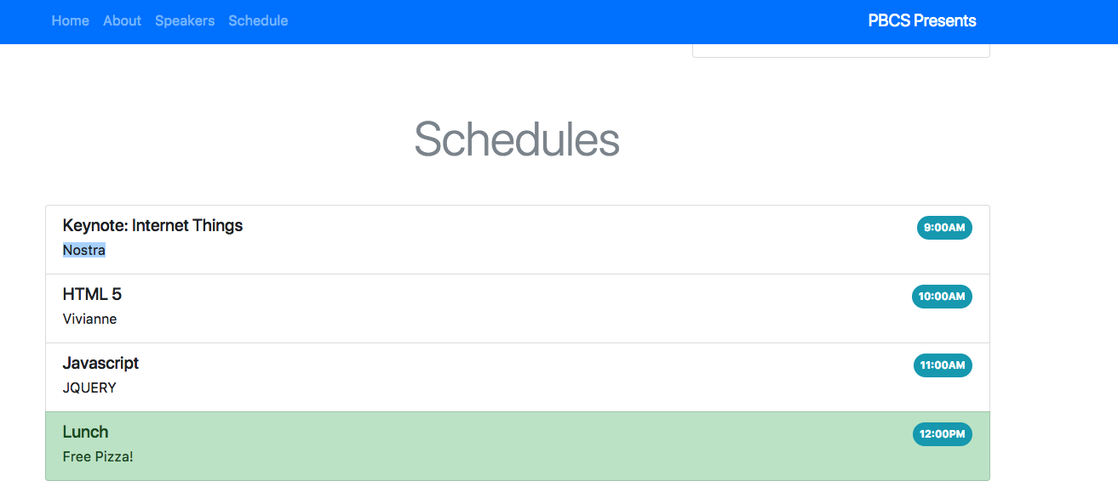
Bootstrap 2

Slide 75
Additional Topics

Slide 76
Bootstrap 2
Homework
Next Slide-PBCS Project
Complete a single page design of the PBCS website including a modal, carousel and using a custom stylesheet
Complete https://teamtreehouse.com/library/framework-basics
Resources: https://startbootstrap.com/template-categories/all/

